Slide 1




TAYLOR AND MACLAURIN
how to represent certain types of functions as sums of power series
You might wonder why we would ever want to express a known function as a sum of infinitely many terms.
Integration. (Easy to integrate polynomials)
Finding limit
Finding a sum of a series (not only geometric, telescoping)

Slide 2
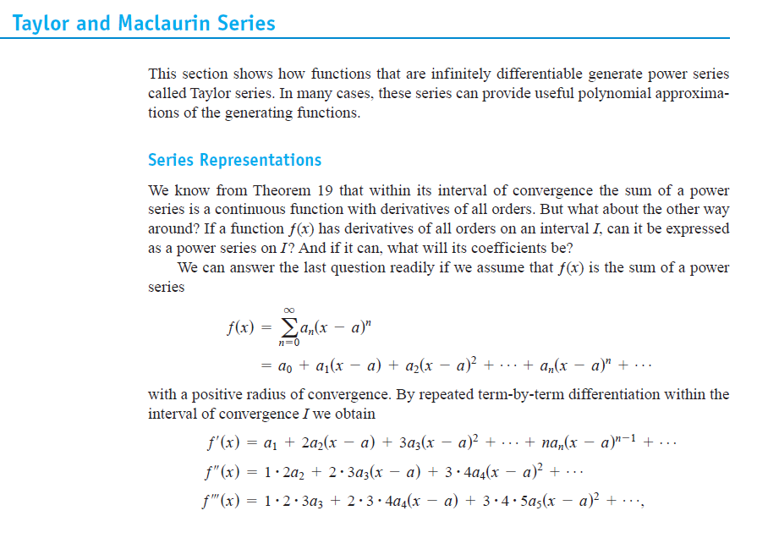

Slide 3
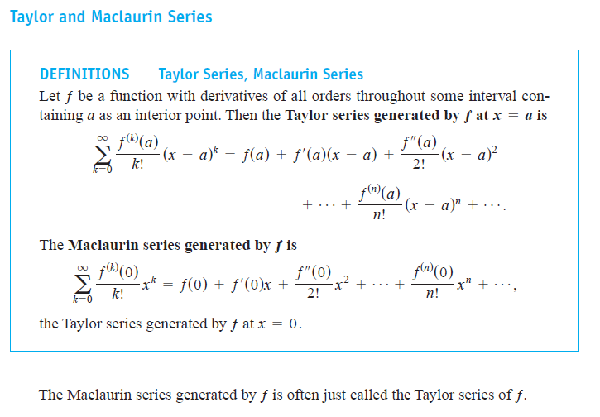

Slide 4
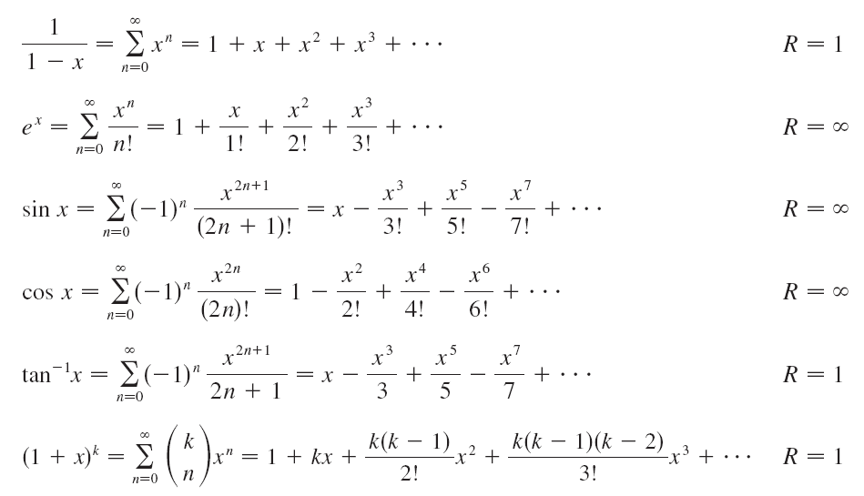

TAYLOR AND MACLAURIN
Important Maclaurin Series and Their Radii of Convergence
MEMORIZE: these Maclaurin Series

Slide 5


TAYLOR AND MACLAURIN
Maclaurin series ( center is 0 )
Example:
Find Maclaurin series

Slide 6
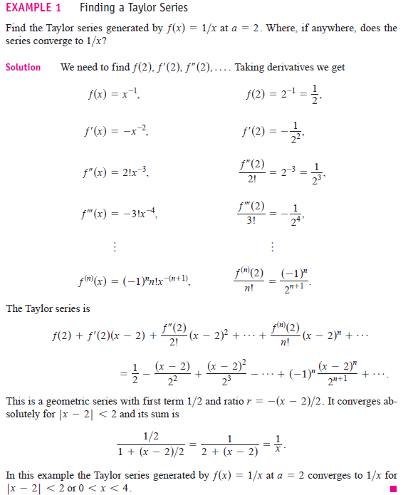
TAYLOR AND MACLAURIN

Slide 7
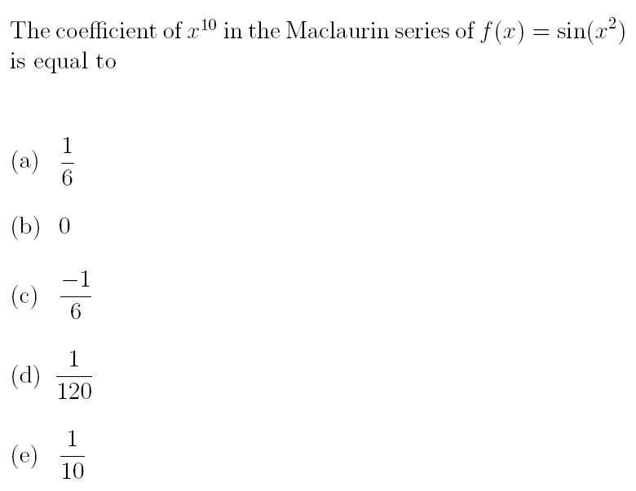

TAYLOR AND MACLAURIN
TERM-091

Slide 8
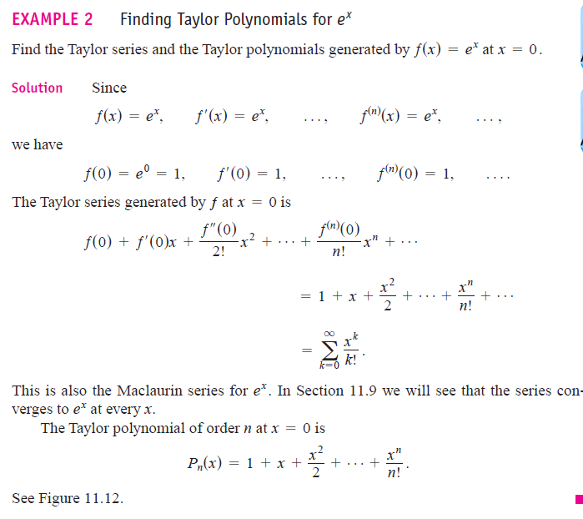
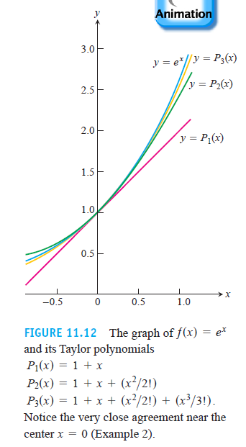
TAYLOR AND MACLAURIN

Slide 9
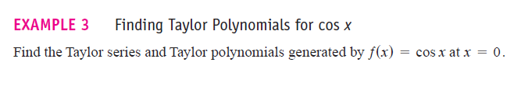
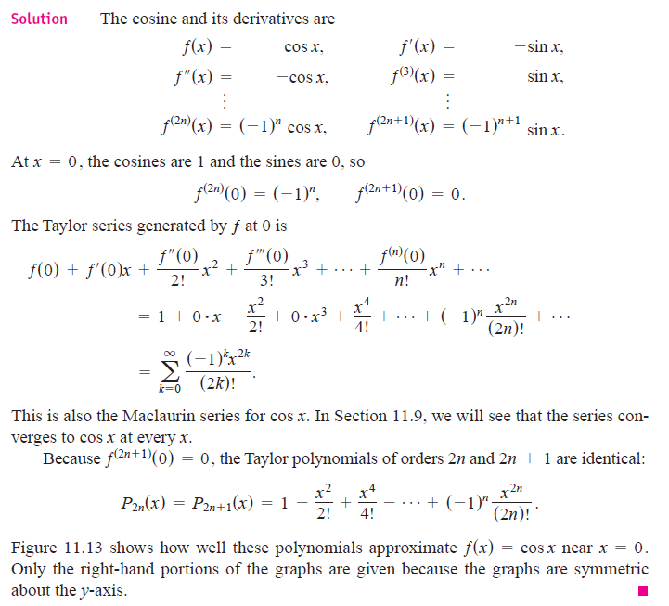
: TAYLOR AND MACLAURIN

Slide 10
TAYLOR AND MACLAURIN
Important Maclaurin Series and Their Radii of Convergence
MEMORIZE: these Maclaurin Series

Slide 11
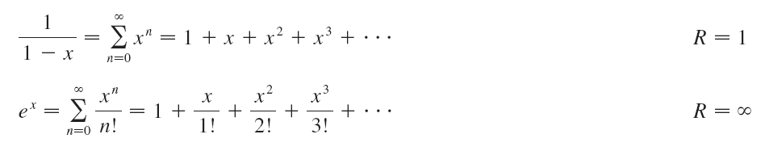

TAYLOR AND MACLAURIN
Important Maclaurin Series and Their Radii of Convergence
Example:
Find Maclaurin series

Slide 12
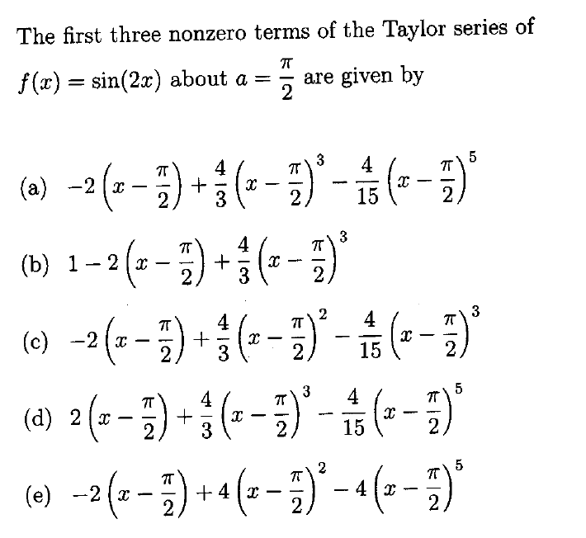
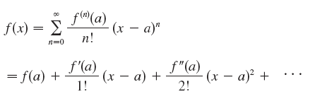
TAYLOR AND MACLAURIN

Slide 13
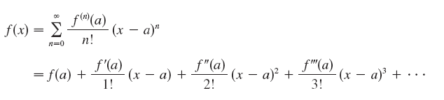
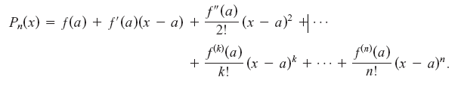
TAYLOR AND MACLAURIN
Taylor series ( center is a )
DEF:
Taylor polynomial of order n

Slide 14
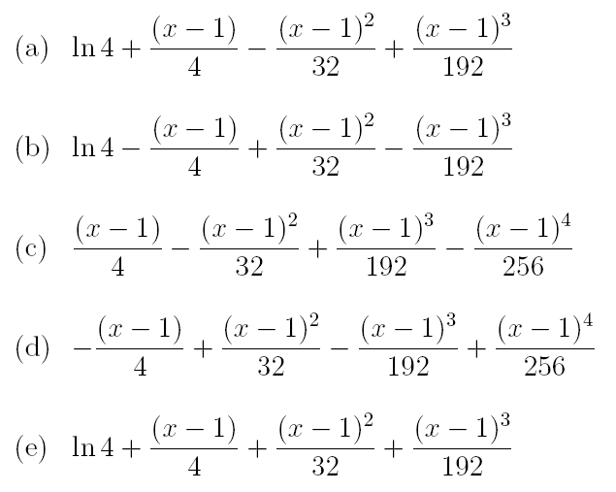
TAYLOR AND MACLAURIN
The Taylor polynomial of order 3 generated by the function f(x)=ln(3+x) at a=1 is:
DEF:
Taylor polynomial of order n

Slide 15
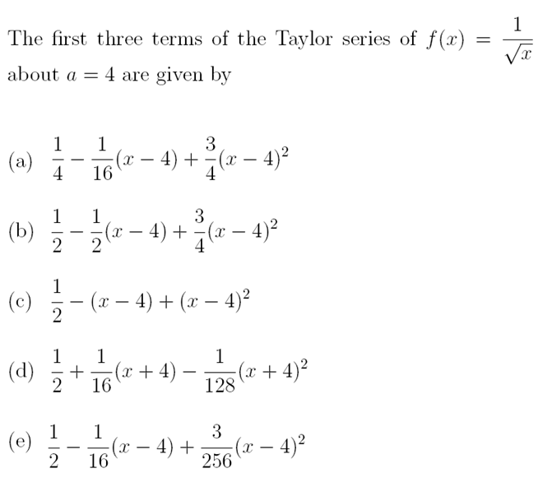
TAYLOR AND MACLAURIN
TERM-101

Slide 16
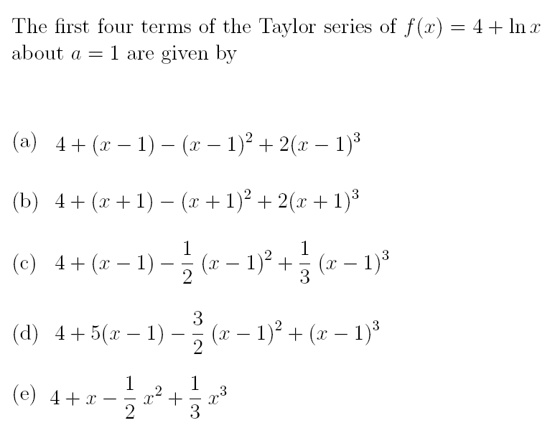
TAYLOR AND MACLAURIN
TERM-081

Slide 17
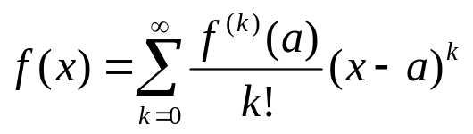
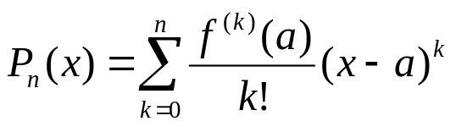
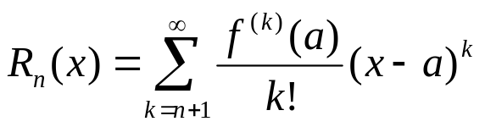

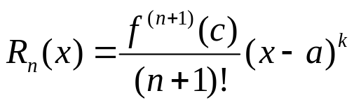

TAYLOR AND MACLAURIN
Taylor series ( center is a )
Taylor polynomial of order n
Remainder
Taylor Series
Taylor’s Formula
Remainder consist of infinite terms
for some c between a and x.
REMARK:
Observe that :

